Slide 1
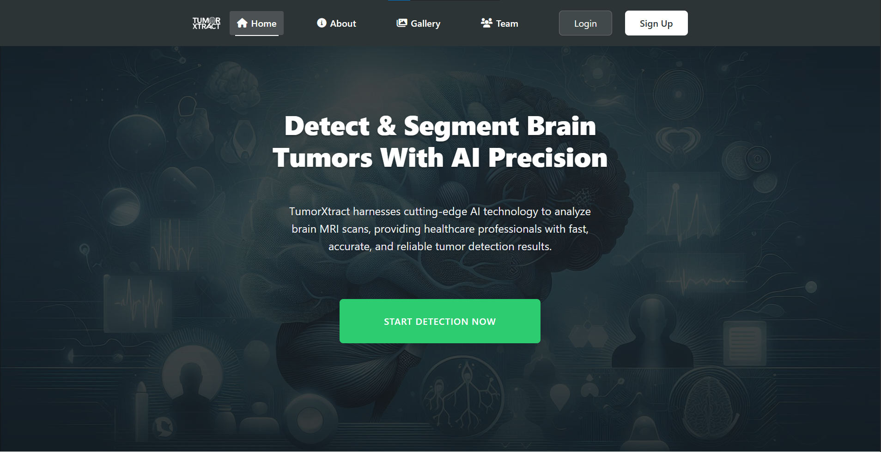
TumorXtract
AI-Powered Detection & Segmentation of Brain Tumors
Graduation Project
Academic Year 2024-2025

Slide 2




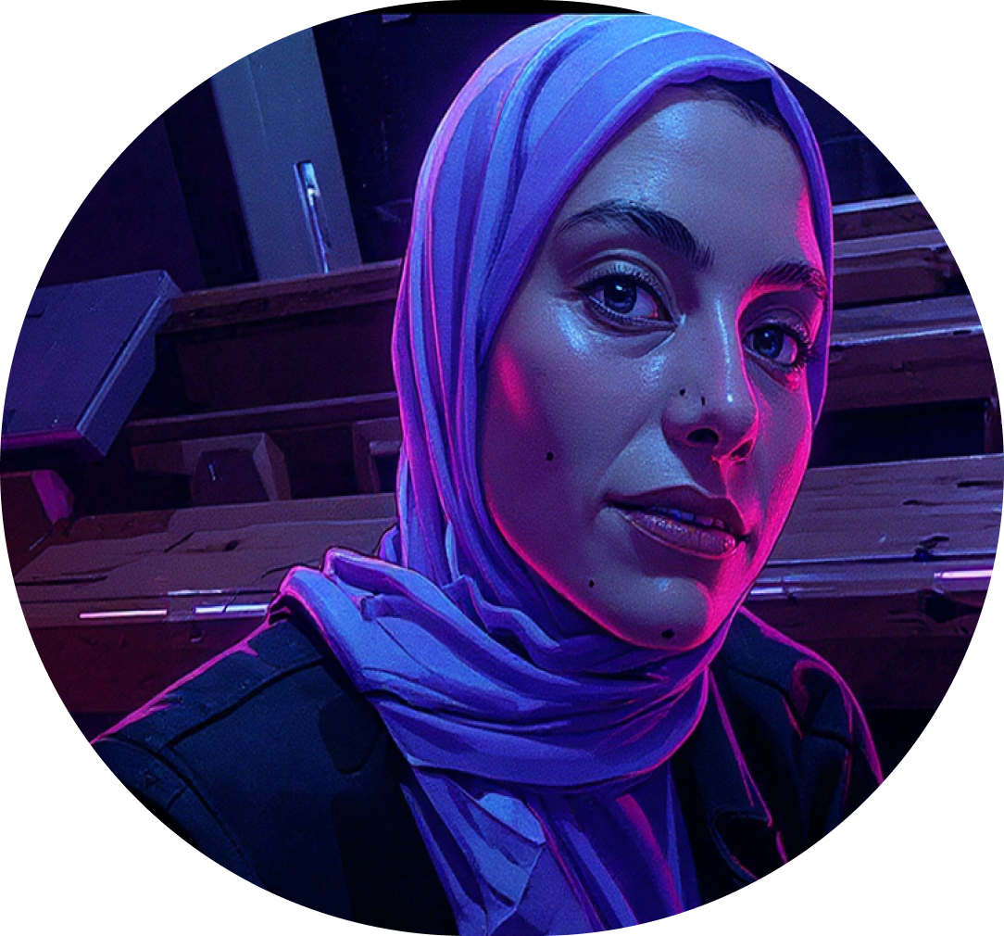

Our Team
Eman Essam Al-dien
Zeyad Mohamed
Marina Essam
Backend Developer
UI/UX & Frontend Developer
AI Developer
Amr Esmaail
Eman Maeawad
George Sherif
Frontend Developer
AI Developer
Python Developer

Slide 3
Table of contents
TumorXtract
1- Introduction & Problem Statement | Why this project is important.
2- Related Work & Background | What others have done.
3- System Design & Architecture | How we designed our system.
4- Implementation & Results | How we built it and how well it works.
5- Application Walkthrough | A visual demo of the final product.
6- Conclusion | Final summary and what's next.

Slide 4
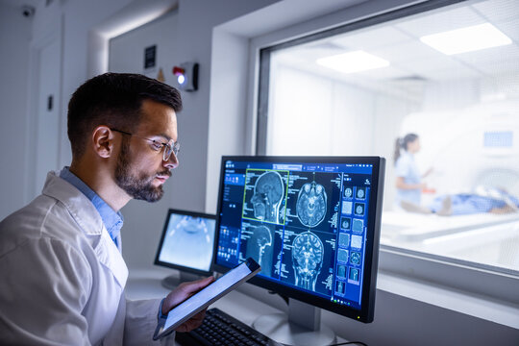



The Challenge of Brain Tumor Diagnosis
Brain tumors are a significant and life-threatening health concern worldwide, requiring early and accurate diagnosis for effective treatment.
The current "gold standard" for diagnosis is the manual analysis of Magnetic Resonance Imaging (MRI) scans by radiologists.
This manual process faces significant challenges:
It is extremely time-consuming and labor-intensive.
It is susceptible to human error, especially in complex cases.
These factors can lead to delayed diagnoses and suboptimal
treatment planning, directly impacting patient outcomes.
These clinical challenges underscore the urgent need for a more
efficient and reliable solution, a need that becomes even clearer
when we look at the scale of the problem.

Slide 5



Motivation: The Scale of the Problem
700,000+
People in the U.S. currently living with a brain tumor.
85,000+
227,000
New cases of brain tumors diagnosed each year in the U.S.
People who die from brain tumors every year worldwide.

Slide 6
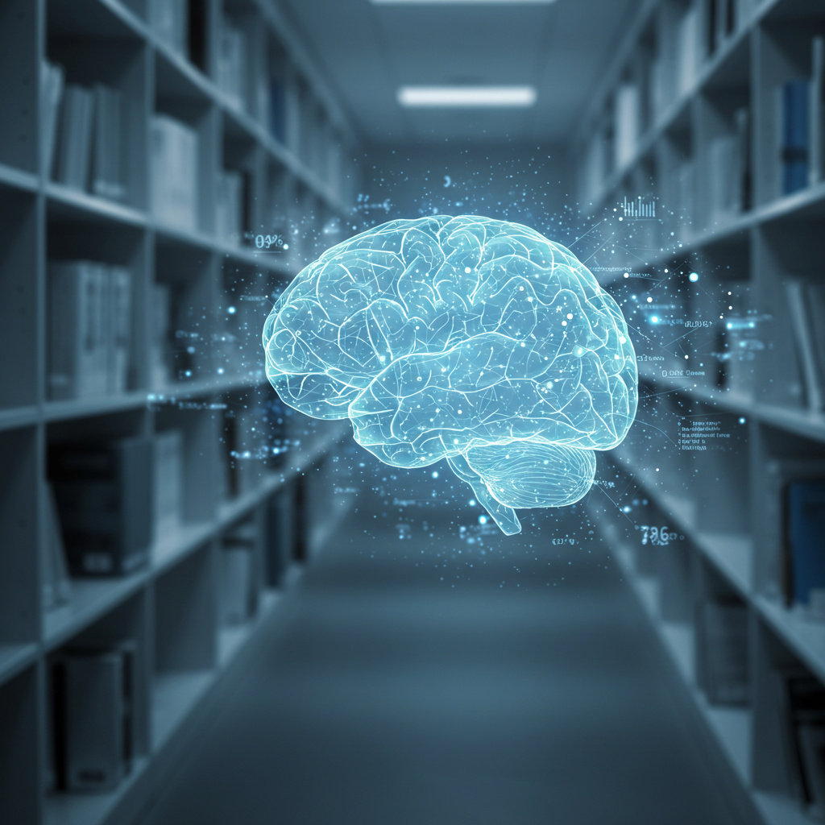
02
Related Work & Our Solution

Slide 7
Related Work: Detection Models
Paper / Authors | Year | Model(s) Used | Reported Accuracy
MRI brain tumor detection using deep learning and machine learning approaches | 2024 | EDN-SVM | 97.93%
Optimized CNN Using Manta-Ray Foraging Optimization for Brain Tumor Detection | 2024 | MRFO-CNN | 99.3%
Brain tumor detection from images and comparison with transfer learning methods and 3‑layer CNN | 2024 | VGG16 / EfficientNetB4 | 98% / 97%
A Robust Approach for Brain Tumor Detection in Magnetic Resonance Images Using Finetuned EfficientNet | 2022 | EfficientNet / Xception | 98.8% / 97.8%

Slide 8
Related Work: Segmentation Models
Paper / Authors | Year | Model(s) Used | Reported Accuracy
High-Resolution Model for Segmenting and Predicting Brain Tumor Based on Deep UNet with Multi Attention Mechanism | 2024 | UNet with Multi-Attention | 99%
Brain Tumor Segmentation and Classification using Optimized Deep Learning. | 2024 | CNN / LSTM | 84.5% / 83.71%
mmformer: multimodal medical transformer for incomplete multimodal learning of brain tumor segmentation | 2022 | mmFormer | 97%
Axial attention convolutional neural network for brain tumor segmentation with multi-modality mri scans | 2022 | AABTS-Net | 98%

Slide 9






Identifying the Research Gap
1- Limitations in Previous Work
2- How TumorXtract Fills the Gap
Comprehensive AI Pipeline: Our project combines both high-accuracy detection and precise segmentation into a single, unified workflow.
Full-Featured Integrated Platform: We delivered a complete, secure web application with a user-friendly GUI, patient management, and role-based access for doctors and assistants.
Focus on Practicality: We addressed the entire problem, from the AI model to the final user interface, creating a tool that is not just academically sound but also clinically useful.
Limited Datasets: Many studies are constrained by small or low-quality datasets, leading to models that may not generalize well.
Incomplete Solutions: Most research focuses only on classification (detection) and ignores the crucial step of segmentation.
Lack of Clinical Tools: Almost no existing research provides a practical, user-friendly interface for healthcare professionals to actually use the AI models.

Slide 10
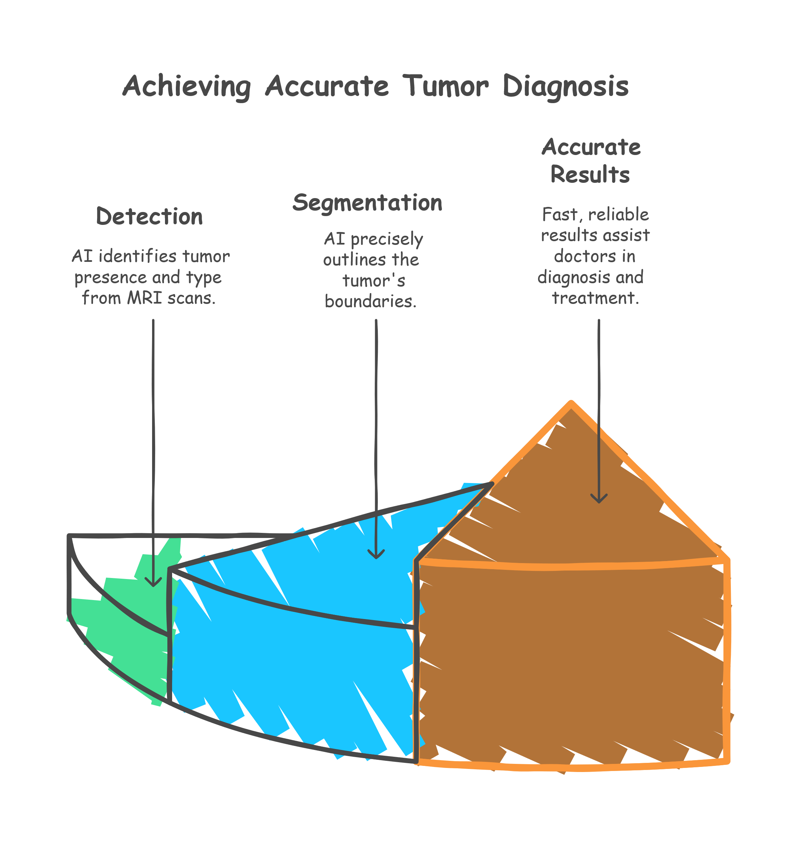
Our Solution: TumorXtract
TumorXtract is a comprehensive, AI-powered web platform designed specifically to support doctors in the diagnostic process.
The system utilizes a two-stage AI pipeline:
- Detection:
First, it accurately identifies the presence and
type of a brain tumor from an MRI scan.
- Segmentation: Second, it precisely outlines the
tumor's boundaries.
The primary goal is to provide fast, accurate, and reliable results to assist doctors with diagnosis, surgical planning, and treatment monitoring.

Slide 11




Accomplished Objectives
Developed a Highly Accurate AI Model
Implemented an Attention U-Net for Segmentation
We successfully developed and validated a classification model that achieved 98.78% accuracy on our test dataset.
This advanced model provides precise, pixel-level segmentation of tumor regions, a critical component for treatment planning.
Delivered a Full-Featured Web Platform
Integrated Key Clinical Features
The AI models were integrated into a secure, robust web application built with an ASP.NET Core backend and a Vanilla JS frontend.
The platform includes comprehensive features essential for a clinical workflow, including secure role-based access for doctors and assistants, full patient record management, and automated PDF report generation.

Slide 12
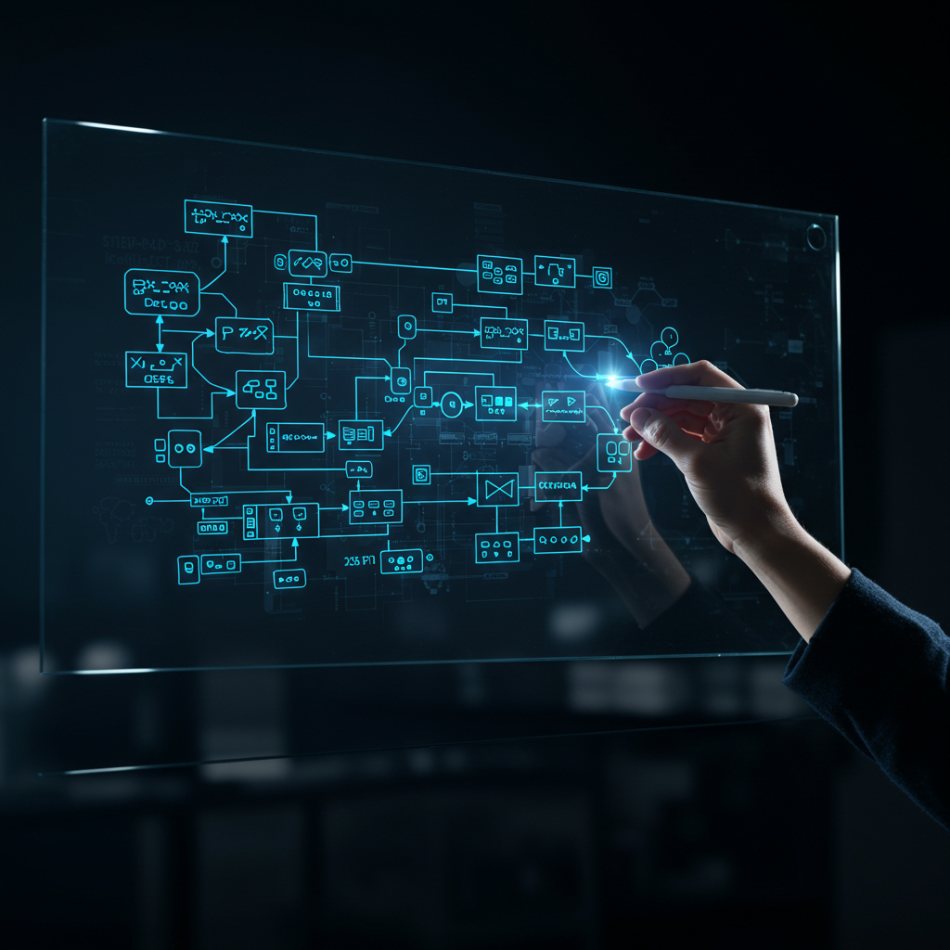
03
System Design & Architecture

Slide 13
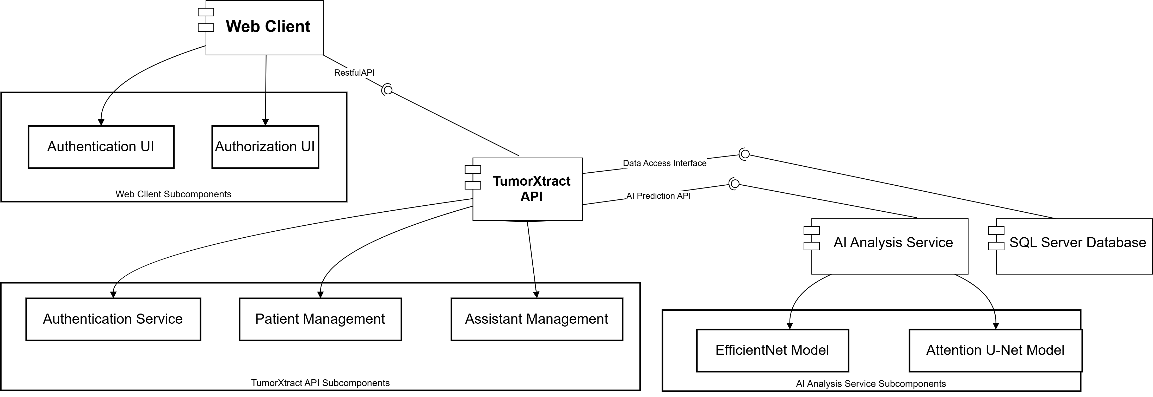
System Architecture
Our system is built on a modern, three-tier microservice architecture. This design separates the user interface from the core business logic and the intensive AI computations, ensuring the system is scalable, maintainable, and robust.

Slide 14


Client & Server Architecture
Frontend (Web Client)
Backend (ASP.NET Core API)
This is the user interface that runs in the doctor's web browser. It is responsible for all user interaction, data presentation, and communication with the backend.
Technologies: Built with HTML, CSS, and Vanilla JavaScript.
This is the core engine of the application. It handles business logic, secure user authentication using JWT , patient data management, and orchestrates all calls
to the external AI service.
Technologies: Built with ASP.NET Core, C#, and Entity Framework Core.

Slide 15


AI Service & Data Storage
AI Analysis Service (Python/Flask)
Database (SQL Server)
This is the system's persistent data store. It holds all user credentials, patient records, assistant permissions, and saved analysis results. It is managed via the backend API using Entity Framework Core.
Technologies: SQL Server, Entity Framework Core.
This operates as a separate microservice, decoupled from the main backend. Its sole responsibility
is to host the trained AI models,
receive an image, perform the two- stage analysis (detection and
segmentation), and return the results
in a structured JSON format.
Technologies: Built with Python, Flask, TensorFlow, and Keras.

Slide 16
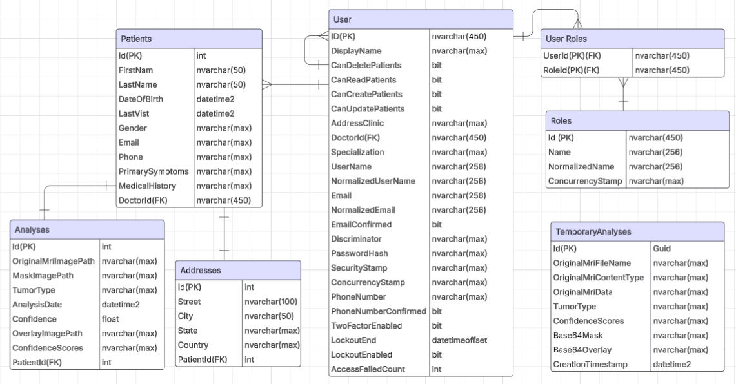
Database Schema
This diagram shows the structure of our SQL Server database. The key tables include Doctors, Assistants, and Patients. As you can see from the relationships, one doctor can have many assistants and many patients. Each patient record can also be linked to multiple analysis results over time, allowing for a complete medical history to be stored within the system.

Slide 17

















Technology Stack
Backend
Frontend
Tools & Platforms
AI & Data Science

Slide 18

04
Implementation & Results

Slide 19
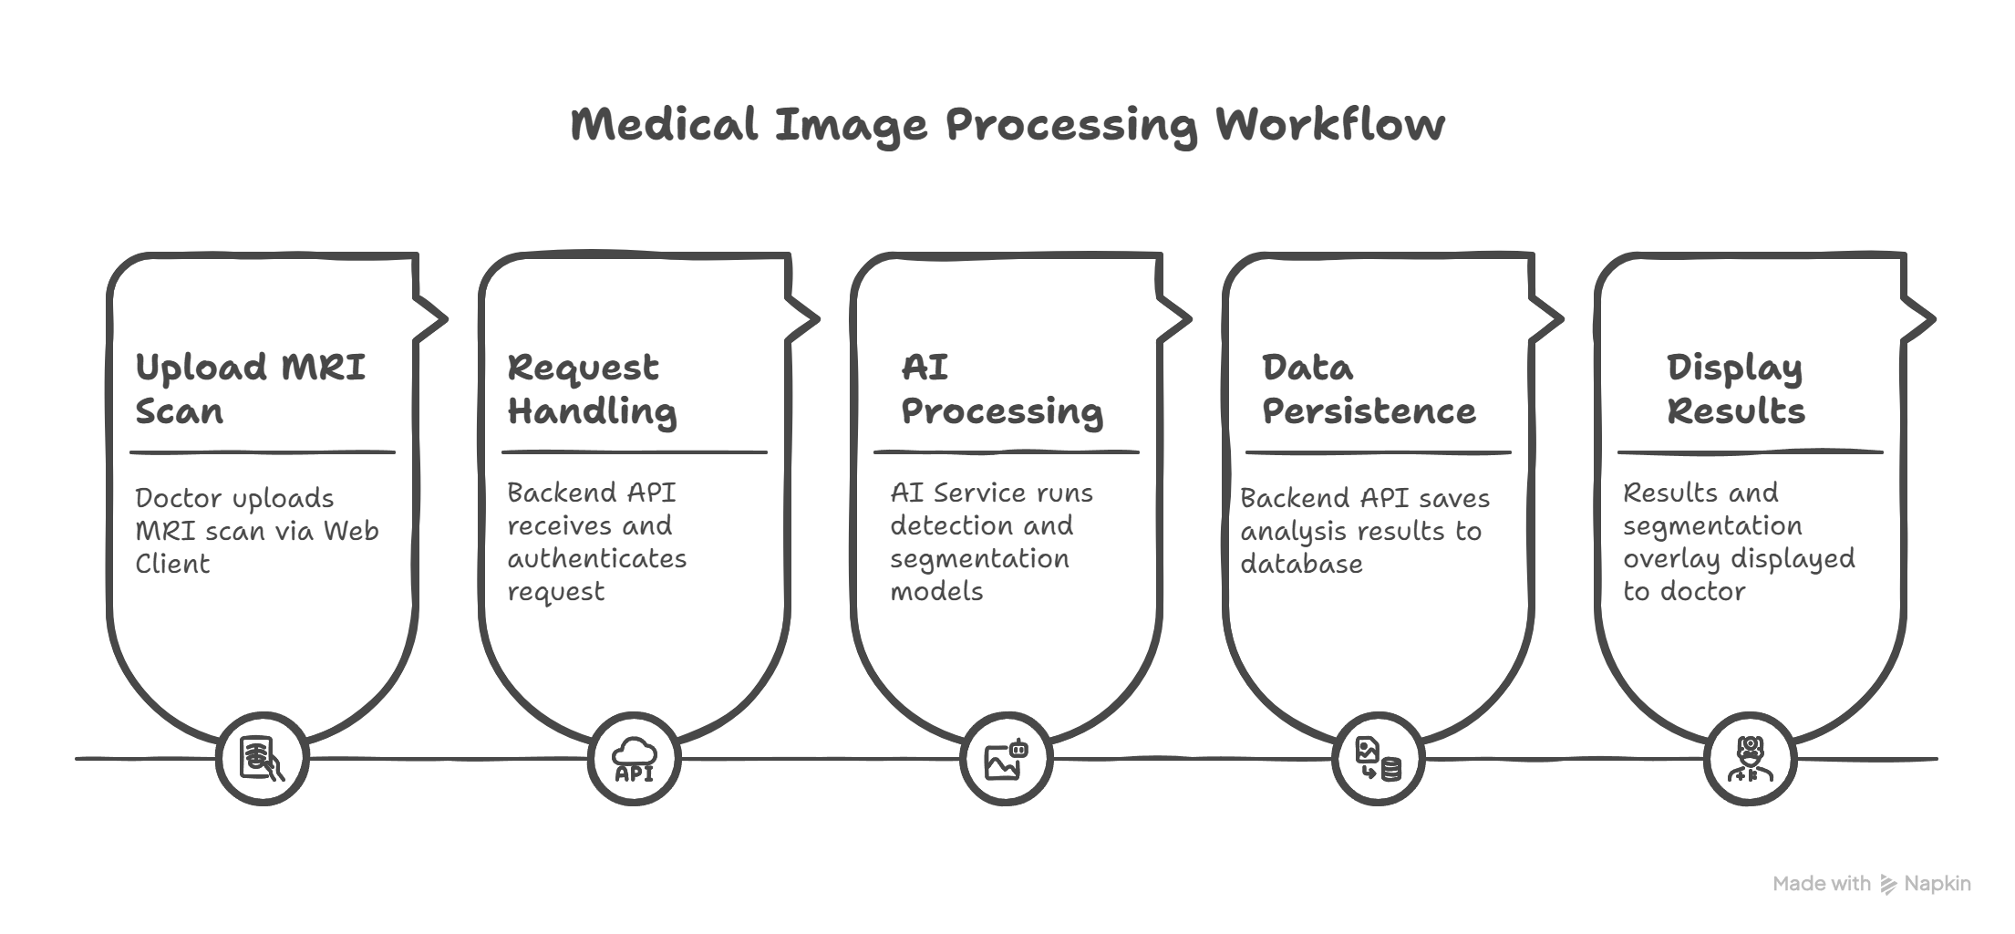
Core System Workflow: MRI Analysis

Slide 20
The Dataset
Data for Detection
Data for Segmentation
For the classification task, we used a comprehensive dataset of 7,022 MRI images, categorized into four distinct classes:
Glioma (1621 images)
Meningioma (1645 images)
Pituitary (1757 images)
No Tumor (2000 images)
For the segmentation task, we used a subset of the data containing 3,064 MRI images. This subset covers the three tumor types (glioma, meningioma, and pituitary) and pairs each image with a corresponding segmentation mask that precisely outlines the tumor region.

Slide 21
Data Preprocessing & Augmentation
For Detection
For Segmentation
Since the detection dataset was already clean and balanced, our focus was on data augmentation to improve the model's ability to generalize and prevent overfitting. We applied a range of techniques to create variations of the training images, including:
Rotation & Rescaling
Brightness & Shear Adjustments
Horizontal Flipping & Zooming
For the segmentation task, it was critical that any augmentation was applied identically to both the MRI scan and its corresponding mask to maintain spatial correspondence. We carefully selected transformations that would not destroy key features, such as:
Horizontal Flip
Rotation
Elastic Transform

Slide 22
AI Model Performance: Classification
Model | Accuracy | Precision | Recall
Xception | 98.70% | 99.24% | 99.10%
EfficientNet | 98.78% | 99.60% | 99.10%
ResNet 50 | 98.86% | 99.20% | 99.70%
We trained and evaluated three different CNN architectures for the classification task. As the results show, while all models performed exceptionally well, we selected EfficientNet as our primary model. Although ResNet50 had a slightly higher recall, EfficientNet provided the best balance of all metrics, with a superior precision of 99.6%, which is critical for minimizing false positives in a diagnostic setting.

Slide 23
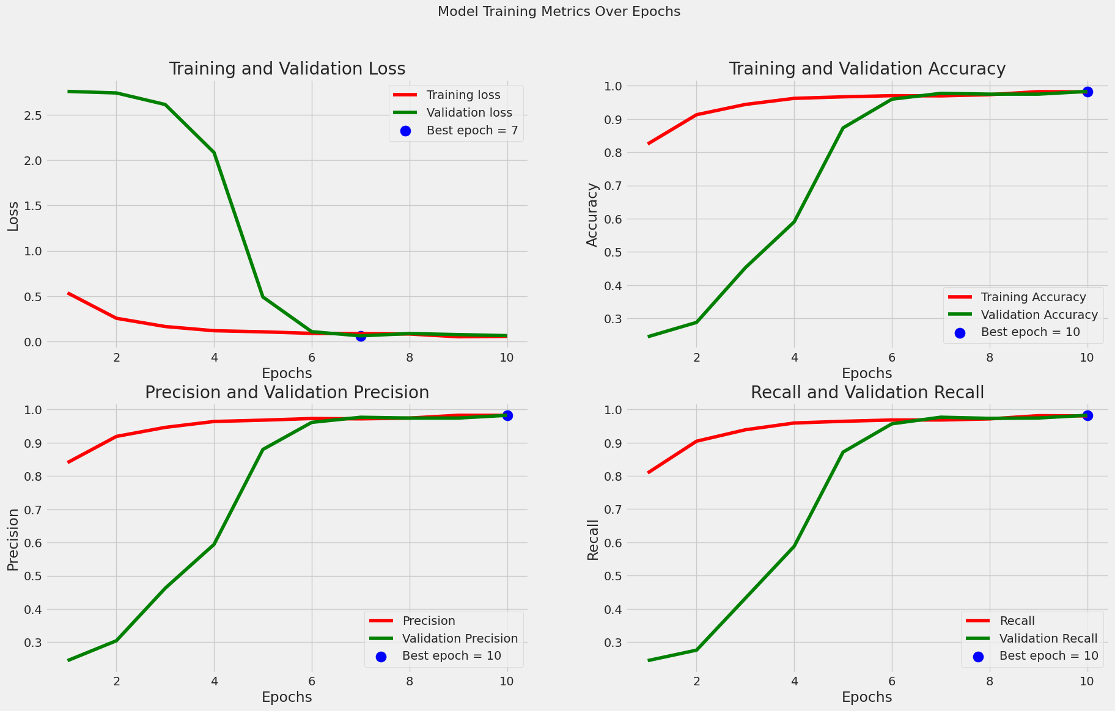
EfficientNet Performance Analysis

Slide 24
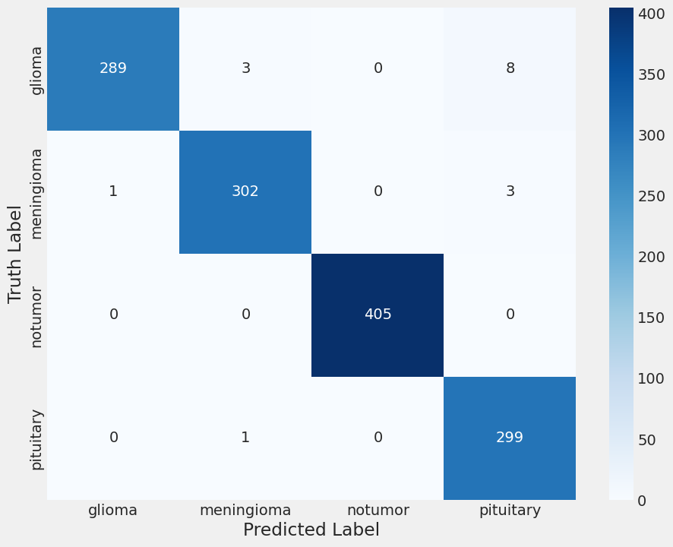
EfficientNet Performance Analysis(cont..)
"To further analyze the performance of our primary
model, a confusion matrix was generated.
The strong diagonal trend from top-left to
bottom-right
confirms a very high number of correct predictions across all classes.
For example, the model correctly identified all 405 'no
tumor' cases and 302 out of 306 'meningioma' cases.
This demonstrates the model's high reliability and its
ability to distinguish between the different tumor types with minimal error."

Slide 25
AI Model Performance: Segmentation
Model | Accuracy | Mean IOU | Mean Dice Coefficient | Dice Loss
Attention U-Net | 99.35% | 82.88% | 83.70% | 16.92%
For the segmentation task, our Attention U-Net model was evaluated using two standard industry metrics: the Dice Coefficient and IOU. Both scores are well above 0.8, indicating a high degree of spatial accuracy and confirming that the model is effective at precisely outlining the tumor boundaries.

Slide 26
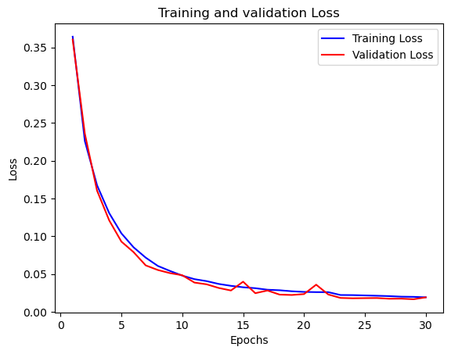
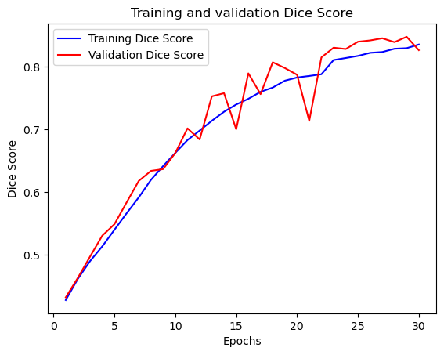
U-Net Performance Analysis

Slide 27
Performance Benchmark: Detection
Paper | Model Used | Accuracy
Brain tumor detection from images and comparison with transfer learning methods and 3‑layer CNN | EfficientNet | 97%
A Robust Approach for Brain Tumor Detection in Magnetic Resonance Images Using Finetuned EfficientNet | EfficientNet | 98.8%
Our Work | EfficientNet | 98.78%
As the comparison shows, the performance of our implemented model is highly competitive with, and in some cases superior to, other existing research in the field, validating our chosen methodology.

Slide 28
Performance Benchmark: Segmentation
Paper / Authors | Model(s) Used | Mean Dice Coefficient | Dice Loss
High-Resolution Model for Segmenting and Predicting Brain Tumor Based on Deep UNet with Multi Attention Mechanism | UNet | 89.78% | 13.50%
Axial attention convolutional neural network for brain tumor segmentation with multi-modality mri scans | AABTS-Net | 82.50% | 17.50%
mmformer: multimodal medical transformer for incomplete multimodal learning of brain tumor segmentation | mmFormer | 84.33% | 15.67%
Our work | U-Net | 83.70% | 16.30%
Our implemented model demonstrates a Mean Dice Coefficient of 83.70%, proving its strong performance and placing it competitively among other state-of-the-art segmentation architectures.

Slide 29
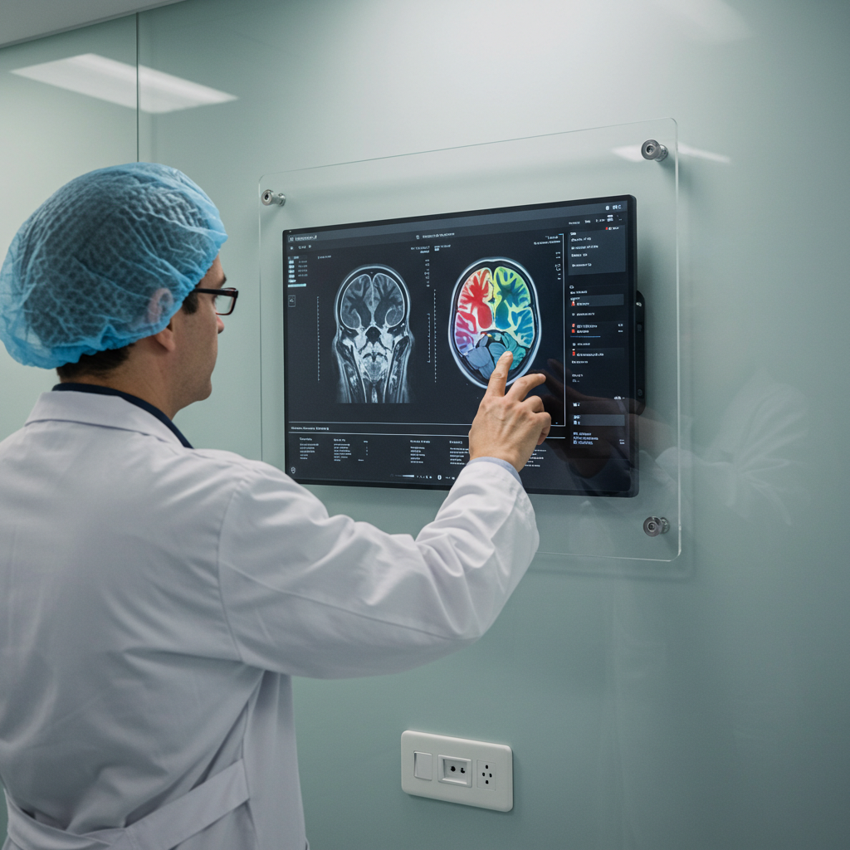
05
Application Walkthrough

Slide 30
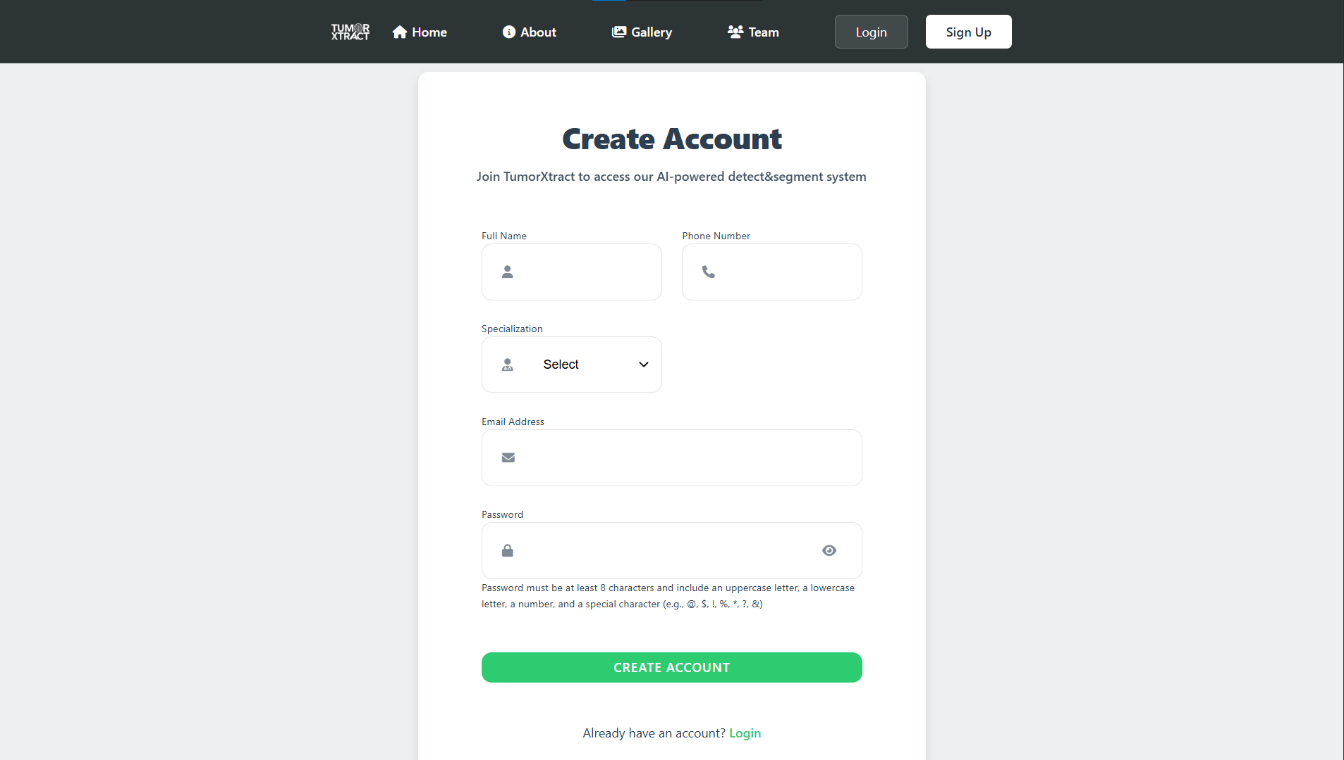
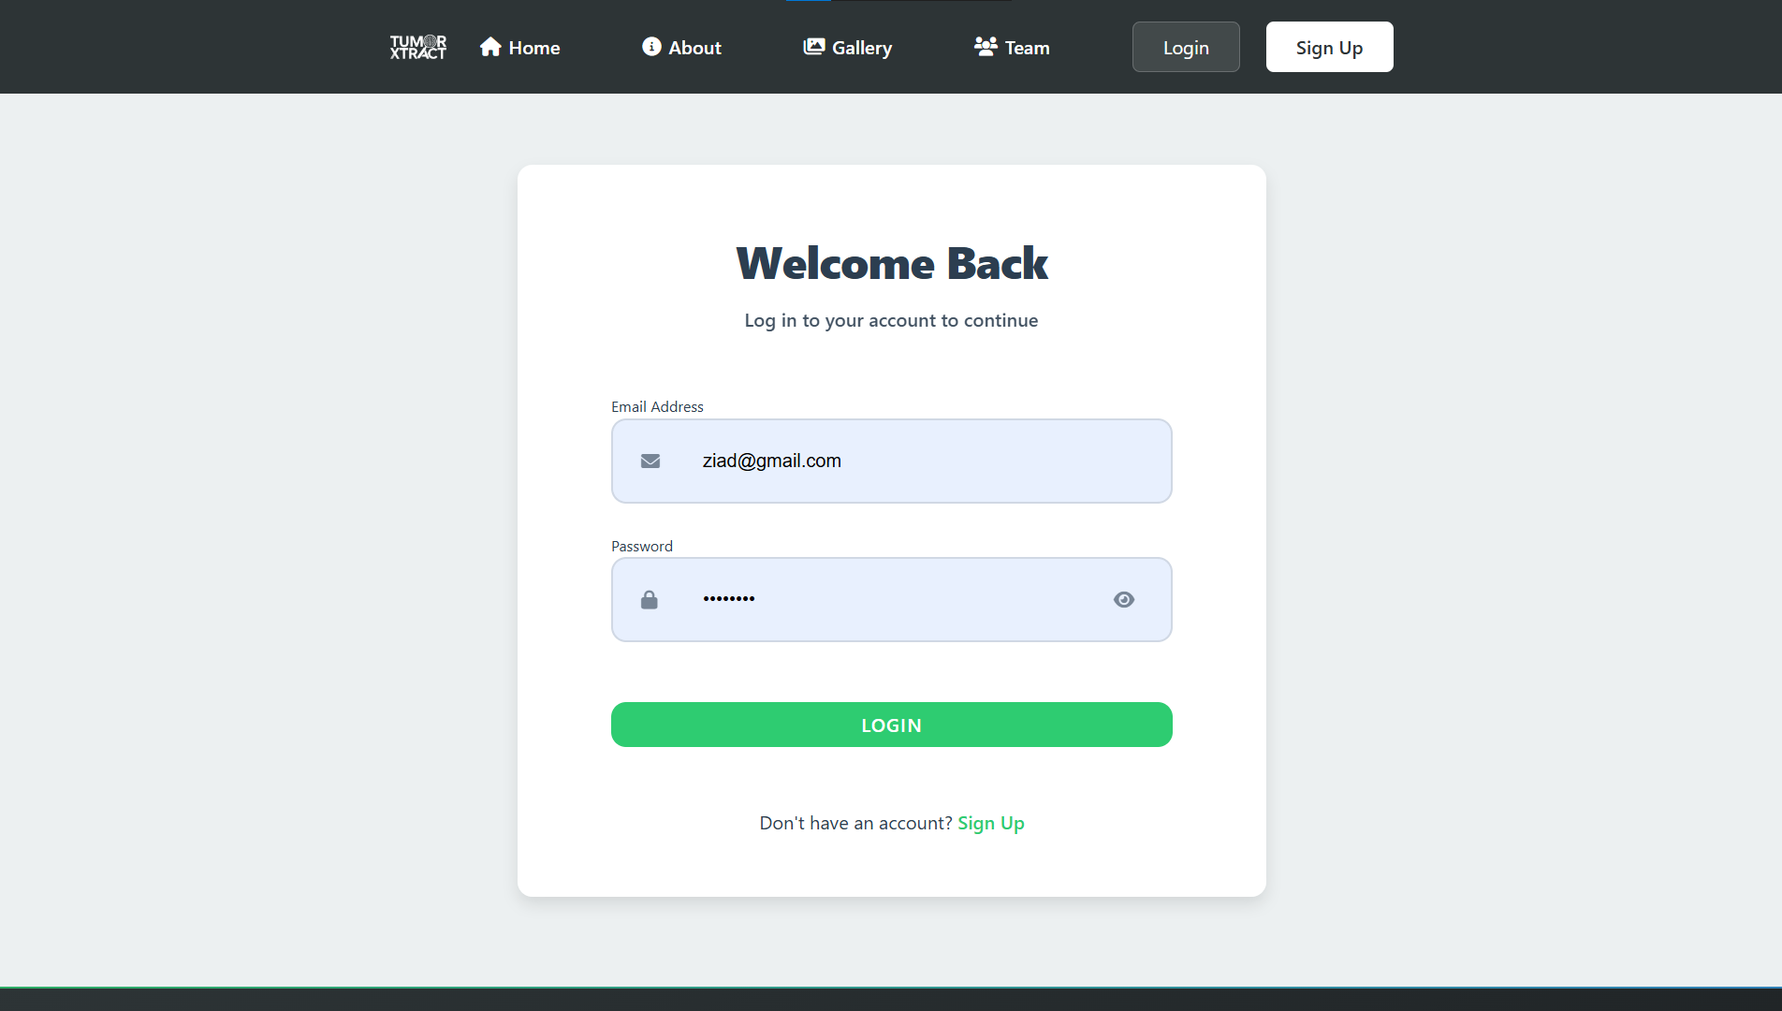
Application Walkthrough: User Onboarding​
Doctor Registration: New doctors can create a secure account through this comprehensive registration form, which captures necessary professional details.​
Secure Login: Registered users, including doctors and their designated assistants, can securely access the clinical dashboard through this portal.​

Slide 31
Application Walkthrough: User Onboarding
Doctor Registration: New doctors can create a secure account through this comprehensive registration form,
which captures necessary professional details.
Secure Login: Registered users, including doctors and their designated assistants, can securely access the clinical dashboard through this portal.

Slide 32
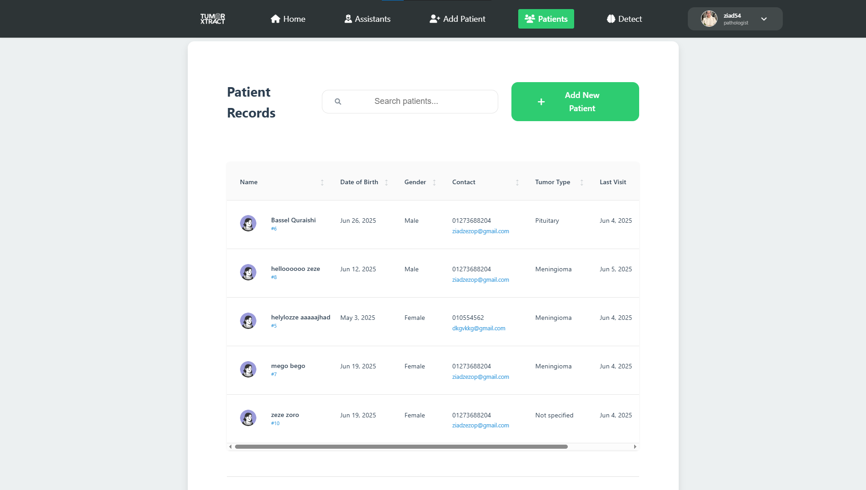
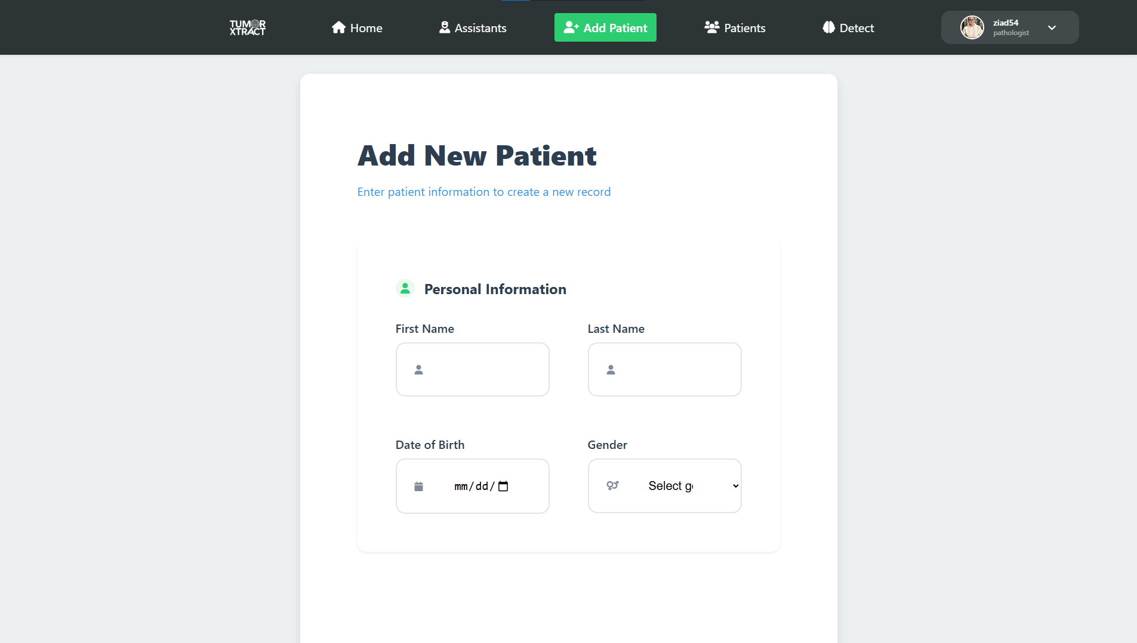
Application Walkthrough: The Main Dashboard
Patient Dashboard: Upon logging in, doctors are presented with this central dashboard, which provides a comprehensive and searchable list of their patients.
Patient Creation: From the dashboard, doctors can easily add new patients to the system by filling out this structured form to create a new record.

Slide 33
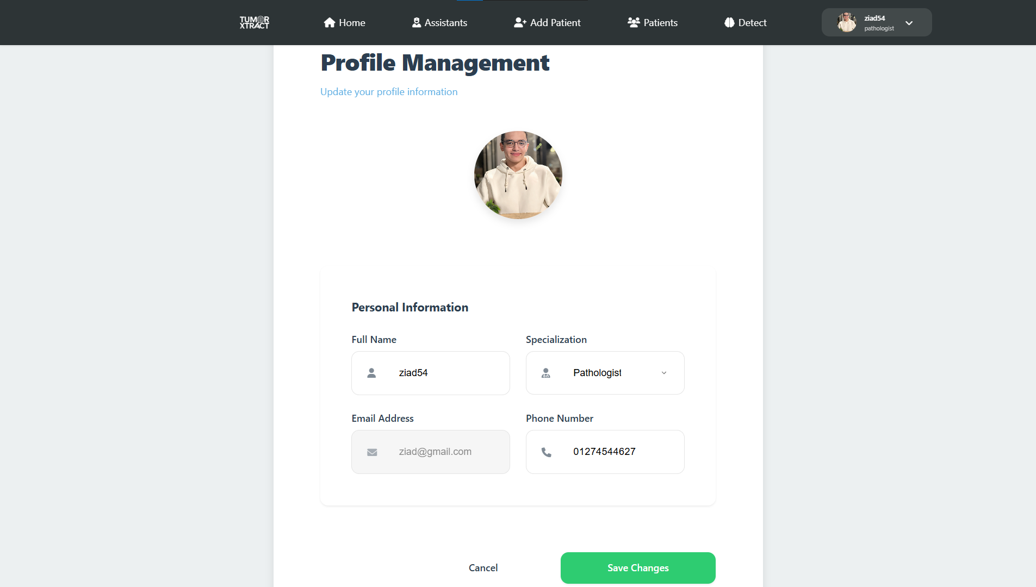
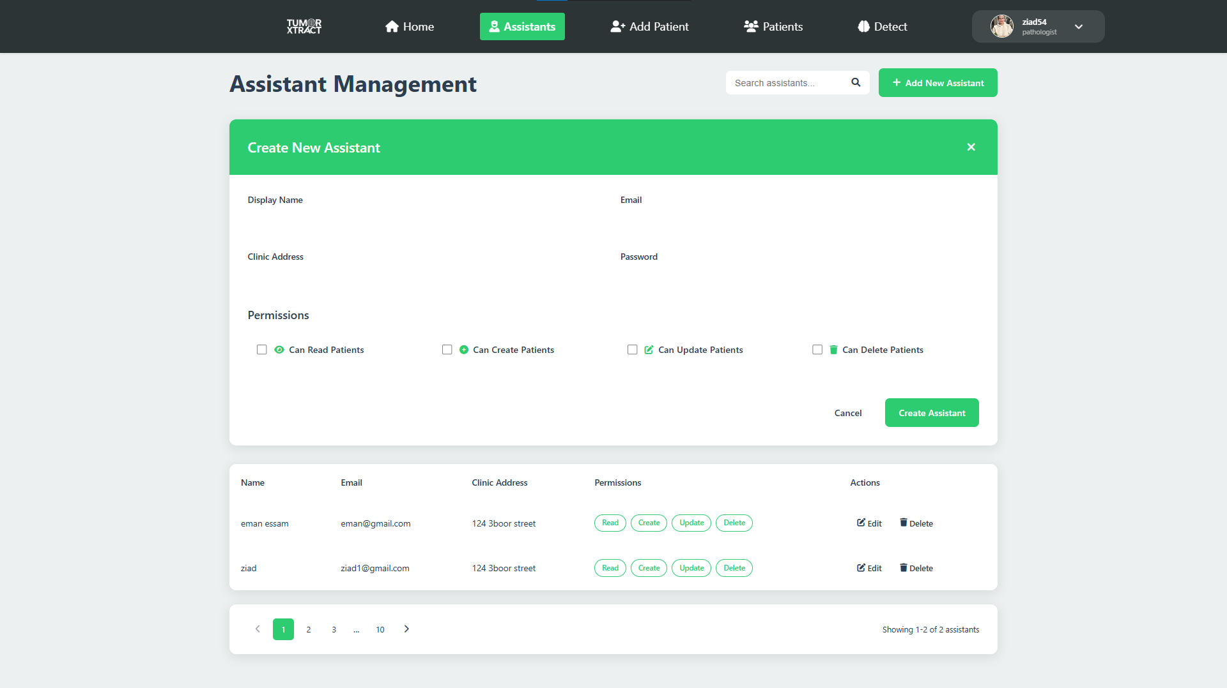
Application Walkthrough: Management Features
Assistant Management: The platform includes a hierarchical user system. Doctors can create and manage accounts for their assistants and assign granular permissions, controlling their access to patient data and system features.
User Profile Management: Doctors have full control over their own profile information, including the ability to update their name, contact details, and professional specialization.

Slide 34
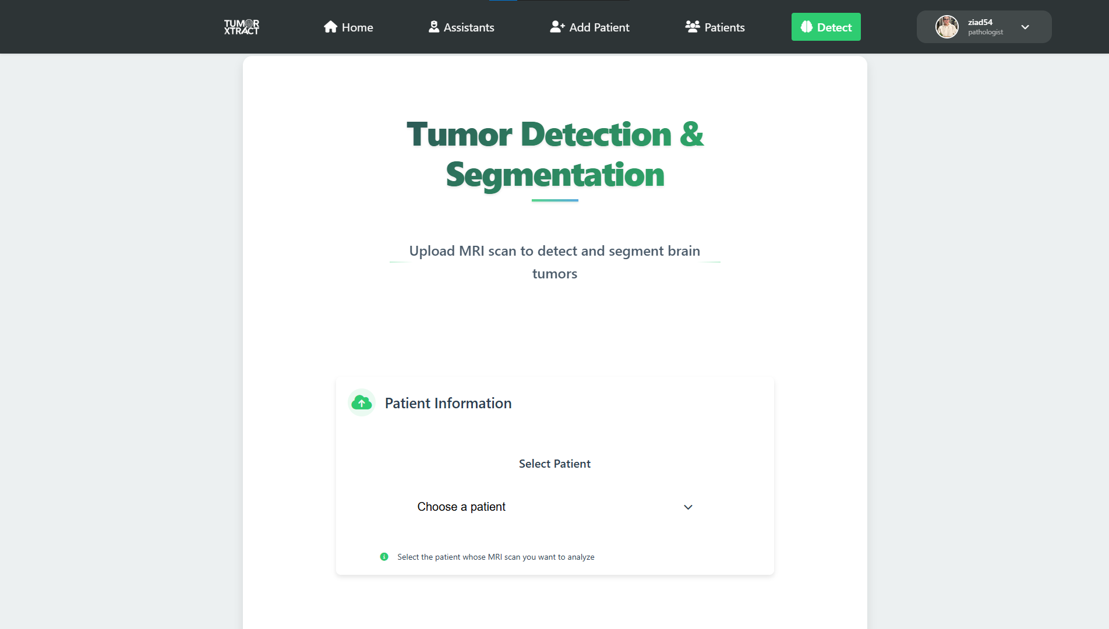
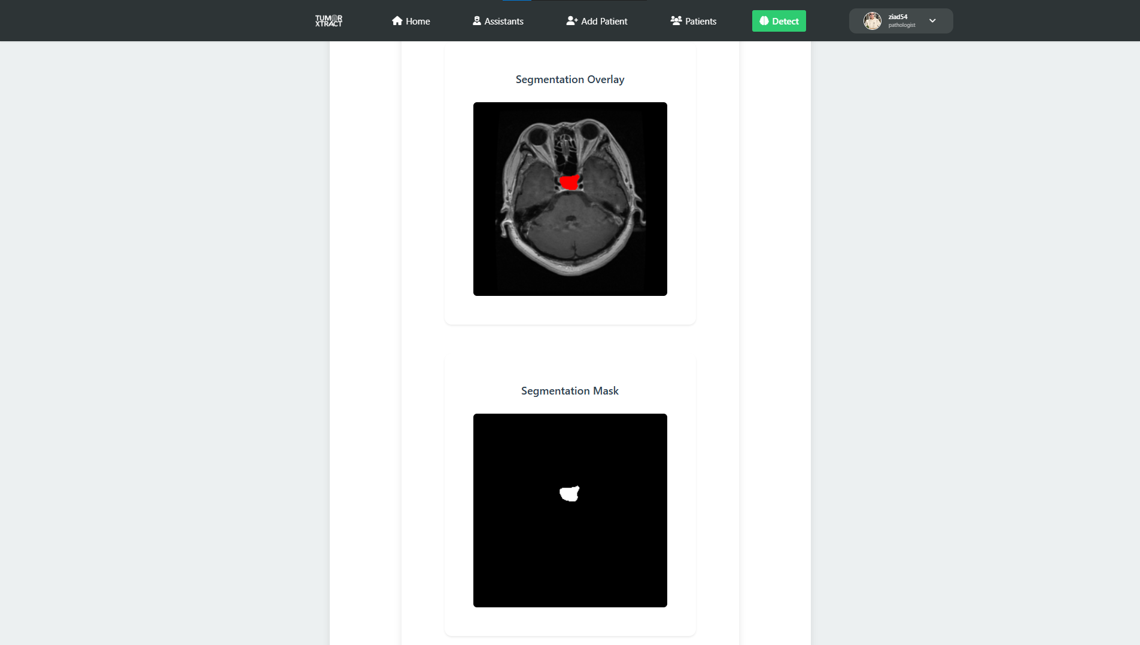
Application Walkthrough: The AI Analysis Workflow
Step 1: Initiate Analysis: The workflow begins on the "Detect" page, where the doctor selects the patient and uploads their MRI scan.
Step 2: Review Results: The system presents a comprehensive results page, including the final diagnosis, confidence scores, and a visual segmentation overlay to highlight the tumor.

Slide 35
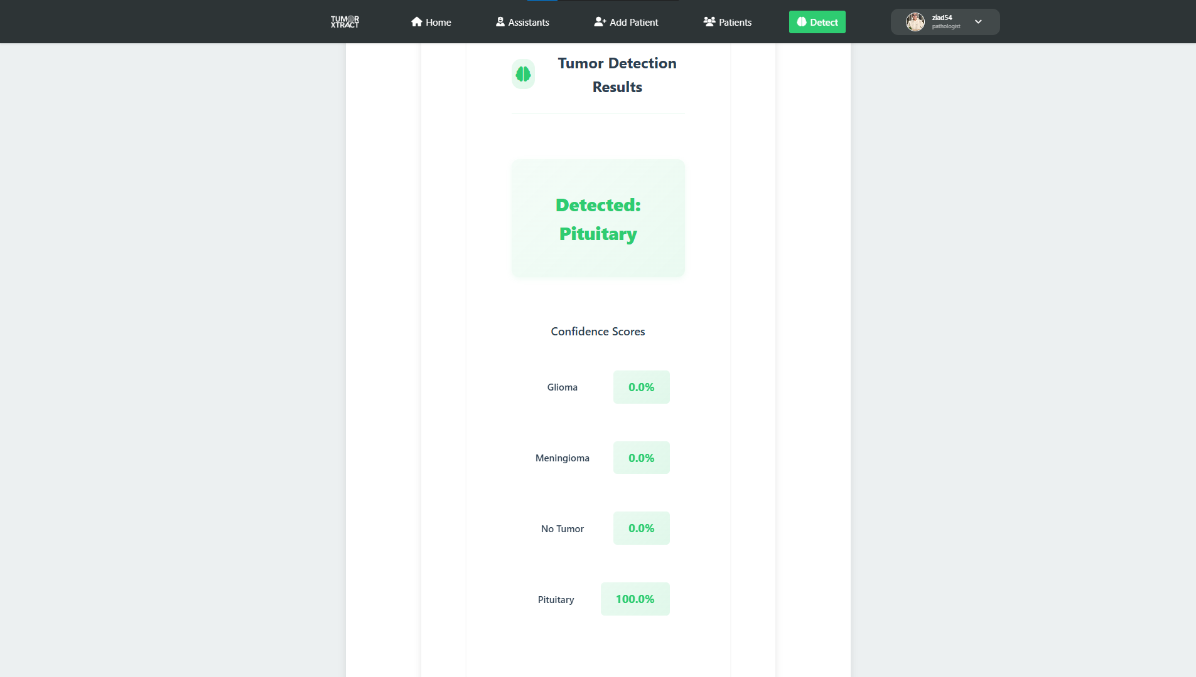
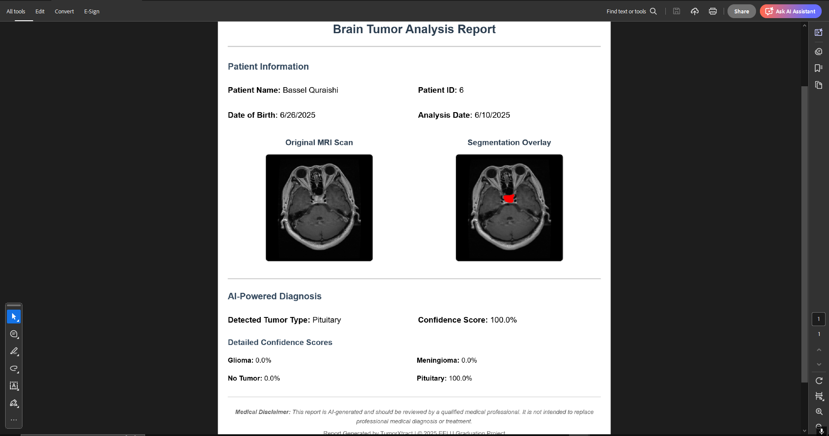
Application Walkthrough: Comprehensive Analysis Results
AI Diagnosis: The system displays the final classification (e.g., "Detected: Pituitary") along with a detailed breakdown of the model's confidence scores for each potential tumor type.
PDF Report Generation: The system can generate a comprehensive, downloadable PDF report of the analysis, including patient data, diagnostic results, and key images, suitable for record-keeping and sharing.

Slide 36
Implementation Challenges & Solutions
Handling AI Generated Images
PDF Report Data Retrieval
Problem: Our Python/Flask AI service processes MRI scans and returns the resulting images (segmentation mask, overlay) as Base64 encoded strings. The ASP.NET backend needed an efficient way to handle these strings and make them accessible as viewable images in the web application.
Problem: A critical bug occurred where clicking the "Download Report" button consistently failed with a "Missing patient data" error, even though a patient was clearly selected in the UI.
Solution: We implemented a handler in the ASP.NET backend that decodes the Base64 strings, saves them as physical image files (e.g., .png or .jpg) on the server, and stores a dynamic, accessible URL path to these images in the database. This decouples the AI service from the file system and ensures images are served efficiently to the frontend.
Solution: Using browser developer tools, we diagnosed a data type mismatch. The patient dropdown menu returned the selected patient's ID as a string (e.g., "7"), but our JavaScript Map data structure required a number (e.g., 7) as the key. We resolved this by implementing a parseInt() function to convert the ID to a number before the lookup, which fixed the bug and allowed the PDF generation to proceed correctly.

Slide 37
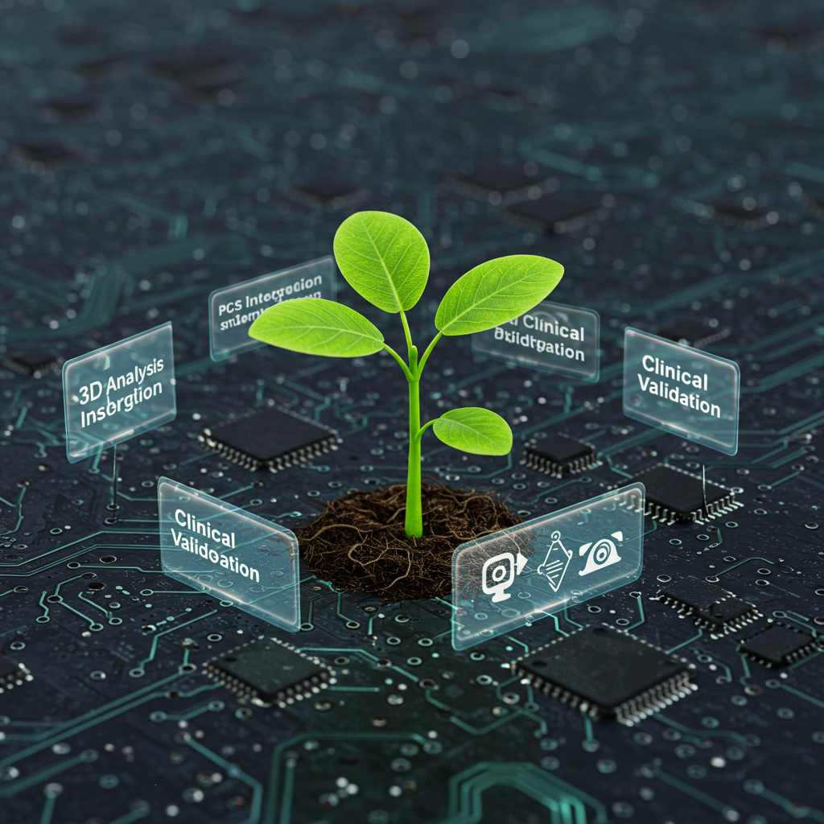
06
Conclusion & Future Work

Slide 38




Conclusion
This project successfully developed TumorXtract, a comprehensive
Platform designed to address the challenges of manual brain tumor
analysis. By integrating a highly accurate AI pipeline with a secure and
user-friendly web application, we have delivered a practical tool for
healthcare professionals.
Our system achieved 98.78% accuracy in tumor classification and
demonstrated robust performance in segmentation. The final platform,
Complete with features like patient management, role-based access
control, and automated PDF reporting, represents a significant step
Forward in making advanced AI diagnostics accessible and useful in a
real-world setting. Ultimately, TumorXtract provides a powerful
solution that can enhance diagnostic workflows, improve accuracy, and
support better patient outcomes."

Slide 39
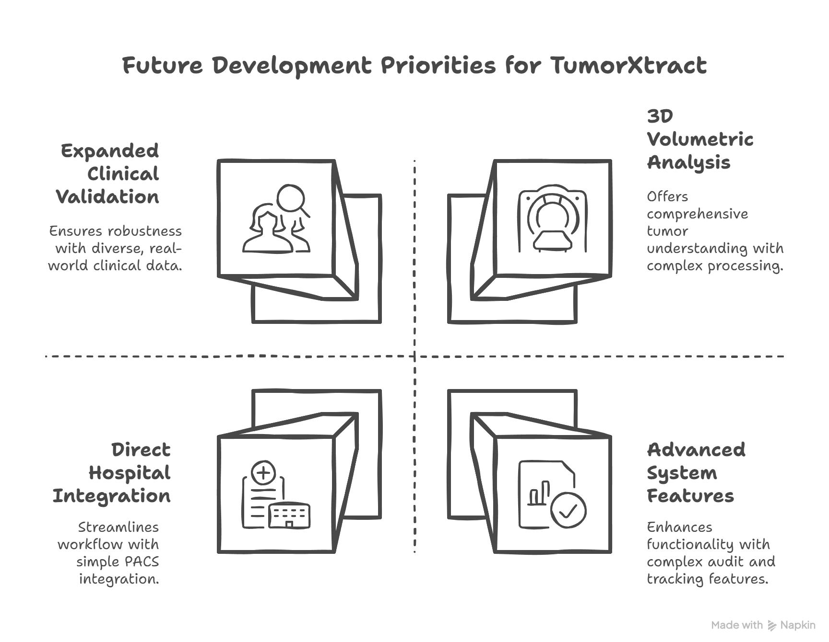
Future Work
TumorXtract

Slide 40





What We Gained From This Project
Full-Stack Development Experience:
We gained hands-on experience in building a complete, three-tier web application, from designing the SQL database and developing the ASP.NET Core backend to creating a responsive frontend with Vanilla JavaScript.
Microservice Architecture & Integration:
We learned how to design and integrate independent microservices by successfully connecting our main backend API with a separate AI service built with Python and Flask, handling complex data transfer like Base64 image strings.
Applied Machine Learning:
We moved beyond theory to apply practical deep learning techniques, including data preprocessing, augmentation, and the training and evaluation of state-of-the-art models like EfficientNet and Attention U-Net.
Advanced Problem-Solving:
We developed critical debugging and troubleshooting skills by solving real-world challenges, such as diagnosing data type mismatches in the frontend logic and resolving complex CSS specificity conflicts.
Teamwork & Project Management:
Most importantly, we learned how to work as a cohesive team to manage a large-scale project from conception to completion, enhancing our collaboration, communication, and project management skills.

Slide 41
References
Abboodi, H. A., Al-Funjan, A., Aldhahab, A., Abedi, W. S., Abdullah, A., & Siraj, A. (2024). High-Resolution Model for Segmenting and Predicting Brain Tumor Based on Deep UNet with Multi Attention Mechanism. International Journal of Intelligent Engineering and Systems, 17(2), 294–310. https://doi.org/10.22266/ijies2024.0430.25
Anantharajan, S., Gunasekaran, S., Subramanian, T., & R, V. (2024). MRI brain tumor detection using deep learning and machine learning approaches. Measurement Sensors, 31, 101026. https://doi.org/10.1016/j.measen.2024.101026
Arohee Sinha. (n.d.). Enhancing Medical Diagnostics: Integrating AI for precise Brain Tumour Detection. Sciencedirect. https://www.sciencedirect.com/science/article/pii/S187705092400721X
Bose, A., & Garg, R. (2024). Optimized CNN using Manta-Ray foraging optimization for brain tumour detection. Procedia Computer Science, 235, 2187–2195. https://doi.org/10.1016/j.procs.2024.04.207
Brain Tumor MRI dataset. (2021, September 24). Kaggle. https://www.kaggle.com/datasets/masoudnickparvar/brain-tumor-mri-dataset
BRATS 2021 Task 1 Dataset. (2021, August 19). Kaggle. https://www.kaggle.com/datasets/ dschettler8845/brats-2021-task1

Slide 42
References(cont..)
Chen Li, Faxue Zhang, & Yongjian Du. (2024, July 7). Classification of brain tumor types through MRIs using parallel CNNs and firefly optimization (15057 (2024)). Nature. https://www.nature.com/articles/s41598-024-65714-w
Khaliki, M. Z., & Başarslan, M. S. (2024). Brain tumor detection from images and comparison with transfer learning methods and 3-layer CNN. Scientific Reports, 14(1). https://doi.org/10.1038/s41598-024-52823-9
Khan, M. F., Iftikhar, A., Anwar, H., & Ramay, S. A. (2024, June 1). Brain Tumor Segmentation and Classification using Optimized Deep Learning. https://jcbi.org/index.php/Main/article/view/528
Mohammed, Y. M. A., Garouani, S. E., & Jellouli, I. (2022). A survey of methods for brain tumor segmentation-based MRI images. Journal of Computational Design and Engineering, 10(1), 266–293. https://doi.org/10.1093/jcde/qwac141
A robust approach for brain tumor detection in magnetic resonance images using finetuned EfficientNet. (2022). IEEE Journals & Magazine | IEEE Xplore. https://ieeexplore.ieee.org/abstract/document/9798829/
Cancer of the brain and other nervous system - Cancer Stat Facts. (n.d.). SEER. https://seer.cancer.gov/statfacts/html/brain.html

Slide 43
Thank you..!
“Gratitude is the memory that lasts forever. Thank you for being with us every step of the way.”
We would like to extend our sincere gratitude to our supervisors for their guidance and support throughout this project:
Dr. Wafaa Samy
TA. Hamada Magdy
Please keep this slide for attribution

